Slide 1
Health Care Delivery in the United States
Brent L. Rollins, RPh, PhD
PHAR 210G
November 21st, 2018

Slide 2
Student Learning Outcomes
1. Identify and describe the paradoxes of the US health care system and why overall costs are high.
2. Identify the major historical events which worked to shape our current health care system.
3. Describe the changes over time in hospitals, medicine, pharmacy, and disease.
4. Explain and differentiate between the public versus private sector within our health care system.
5. Identify global patterns in health care and differentiate where the US excels and where it does not.
6. Identify the impact of the Affordable Care Act.

Slide 3
Paradoxes of the U.S. Health Care System
Highest health care standards
Professional and facility licensures
Professional and facility certifications
Drug and medical device testing
Most advanced technology
Highest expenditure per capita
Approximately 17.9% of GDP
Approximately $10,348 per resident
https://www.cms.gov/Research-Statistics-Data-and-Systems/Statistics-Trends-and-Reports/NationalHealthExpendData/NationalHealthAccountsHistorical.html
https://www.cms.gov/Research-Statistics-Data-and-Systems/Statistics-Trends-and-Reports/NationalHealthExpendData/NationalHealthAccountsHistorical.html

Slide 4
Paradoxes of the U.S. Health Care System
Health Care Spending - Kaiser 2012 Data
Why costs/spending so high?
1) High spending on health care technologies
2) Aging population
3) Increased insurance coverage
4) Decreased out-of-pocket
5) Waste, fraud, and abuse

Slide 5
Paradoxes of the U.S. Health Care System
However…
Fragmentation of health care regulation, financing and delivery
Focus on treatment versus prevention
High rate of medical errors
Socioeconomic and racial disparities in outcomes
Not everyone with adequate health insurance

Slide 6
Back in the Day
1850 – 1900
Home care and family influence
Medicinal herbs and remedies
Humoralism
Infectious diseases most critical problem
Inadequate sewage/water
1900 – 1945
1906 – Food and Drugs Act
1922 – Banting & Best
1928 – Alexander Fleming
“Era of Antibiotics”
Disease shift

Slide 7
Back in the Day
1945 – 1999
Rise of chronic illness
1946 – Hill-Burton Act
Hospital Growth
1965 – Medicare & Medicaid
1973 – Health Maintenance Organization Act
Vastly improved technology
2000 – Present
“Best” and “Worst”

Slide 8
Back in the Day
Early 20th Century – Health Care Payment
Cash
“In Kind”
The Depression
Begins insurance or pre-payment plans
1929: Baylor University
1938: Kaiser Permanente
1939: “Blue Shield”
Continued growth of insurance

Slide 9
Continuity and Change in Health Institutions and Professions
Hospitals
Early 19th-century
Post Civil War
Germ Theory of Disease
Improving aseptic/antiseptic and surgical techniques
Improving technology (anesthesia, X-rays)
U.S. Hospital Growth
From 100 to approximately 5,700
General hospitals
Specialty hospitals (e.g. mental, children’s)
Sponsored by religious, ethnic, and physician groups

Slide 10
Continuity and Change in Health Institutions and Professions
Hospitals
Hill-Burton Act
Distributed $4.6 billion in grants and $1.5 billion in loans from 1946 to 1997 (http://www.hrsa.gov/gethealthcare/affordable/hillburton/compliance.html)
Currently
http://www.aha.org/aha/resource-center/Statistics-and-Studies/fast-facts.html

Slide 11
Continuity and Change in Health Institutions and Professions
Medicine
1910: Medical Education in the United States and Canada (a.k.a. “The Flexner Report”)
Higher accreditation standards for medical schools
Higher admission standards for medical students
Fewer schools and students
Abandoned the apprenticeship model
Standardized 4-year curriculum (2 didactic, 2 clinical)
Post WWII
“Biomedical Model” in research and practice

Slide 12
Continuity and Change in Health Institutions and Professions
Pharmacy
1900: 53 colleges and depts. of pharmacy; apprenticeships no longer adequate.
First = ?
1922: APA Code of Ethics
1932: Minimum 4 year curriculum mandated (AACP).
1975: Pharmaceutical care concept advanced
2000: 6-year Pharm.D. curriculum for all new students (1989 Mandate by ACPE)

Slide 13
Health Policy Overview: Public and Private
PUBLIC vs. PRIVATE
Public
Funded by the government (i.e. taxes)
Entitlement
Examples - medicare, tricare
Private
Not funded by taxes
Usually through employer
Examples – aetna, humana, blue cross

Slide 14
Health Policy Overview: Public and Private
Over time….
Increased dependence on third-party payments
Employers offered health insurance as a benefit to attract workers; added to negotiations by unions
Wage controls excluded benefits (i.e. health insurance)
Tax deductibility of health insurance benefit as an expense for employers (but not individuals)

Slide 15
Health Policy Overview: Public and Private
Important Policy Changes
1965: Medicare/Medicaid instituted
1973: Health Maintenance Organization Act
Required all employers w/ more than 25 employees to offer at least one HMO option in their health plan
1996: Health Insurance Portability and Accountability Act (HIPAA)
1997: State Children’s Health Insurance Plan (S-CHIP)
2003: Medicare Prescription Drug Improvement and Modernization Act (MMA)

Slide 16
Health Policy Overview: Public and Private
 | Private Sector |  | Public Sector
 | Insured | Uninsured | Medicaid | Medicare | Federal Beneficiaries
Preventive Care | Private Physician / Employer | Local Health Department | Local Health Department or Primary Care | Private Physician | Department of Veterans Affairs Public Health Service
Ambulatory Care | Private Physician | Public Hospital/ER | Public / Private ER | Private Physician
Hospital Care | Private Community Hospital | Public Hospital | Public / Private Hospital | Private Community Hospital

Slide 17
Health and Sickness Patterns in Historical Perspective
From beginning to end of the 20th-century:
Acute to Chronic
Life expectancy increased almost 60%
Three factors:
Improved standard of living (lifestyles)
Hygiene
Nutrition/Diet
Housing
Advances in public health
Progress in medical practice

Slide 18
Health and Sickness Patterns in Historical Perspective
1900 |  | 2016
Cause | % of all deaths | Cause | % of all deaths
Influenza & Pneumonia | 11.8 | Heart Disease | 23.4
Tuberculosis | 11.3 | Cancer | 22.0
GI Disease | 8.3 | Accidents | 5.9
Heart Disease | 8.0 | Chronic Lower Respiratory | 5.6
Senility, ill-defined | 6.8 | Cerebrovascular | 5.2
Stroke | 6.2 | Alzheimer’s | 4.2
Renal | 4.7 | Diabetes | 2.9
Accidents | 4.2 | Influenza & Pneumonia | 1.9
Cancer | 3.7 | Renal | 1.8
Diphtheria | 2.3 | Suicide | 1.6
https://www.cdc.gov/nchs/data/nvsr/nvsr67/nvsr67_06.pdf

Slide 19
Health and Sickness Patterns Around the Globe
Around the Globe
Causes of Death
http://www.who.int/mediacentre/factsheets/fs310/en/
Quality Indicators****
https://www.healthsystemtracker.org/dashboard/
KNOW**. US below average life expectancy
http://www.commonwealthfund.org/publications/issue-briefs/2015/oct/us-health-care-from-a-global-perspective

Slide 20
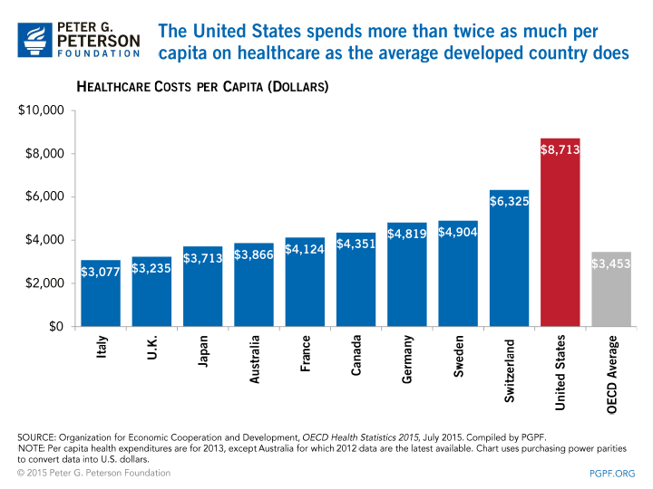
Health and Sickness Patterns Around the Globe
Around the Globe
Expenditures

Slide 21
Health Care Reform
Affordable Care Act
Signed into law on March 23, 2010
Immediate Effects - http://www.kaiserhealthnews.org/stories/2010/march/22/immediate-effects-health-reform.aspx
End of pre-existing condition clause
Dependant coverage until age 26
Ban on lifetime limits of coverage
Small business tax credits
Plans must include fully covered preventative care
Indoor tanning services tax
Nutrition content disclosure – chain restaurants
http://www.healthcare.gov/law/index.html

Slide 22
Health Care Reform
Affordable Care Act
Provisions:
Must obtain at least a minimum amount of health insurance or pay a penalty
Private, individually, Medicaid, subsidies
Change in health insurance performance activities
Previous slide
Established insurance exchanges on a state basis
Expansion of the Medicaid program
http://www.healthcare.gov/law/index.html

Slide 23
Health Care Reform
Affordable Care Act
Impact:
https://www.nytimes.com/interactive/2016/10/31/upshot/up-uninsured-2016.html?_r=1
http://www.commonwealthfund.org/publications/fund-reports/2016/feb/aca-economy-five-year-perspective
https://www.commonwealthfund.org/publications/issue-briefs/2018/oct/affordable-care-act-impact-small-business
Current:
https://www.npr.org/tags/131849999/affordable-care-act
https://khn.org/

Slide 24
Student Learning Outcomes
1. Identify and describe the paradoxes of the US health care system and why overall costs are high.
2. Identify the major historical events which worked to shape our current health care system.
3. Describe the changes over time in hospitals, medicine, pharmacy, and disease.
4. Explain and differentiate between the public versus private sector within our health care system.
5. Identify global patterns in health care and differentiate where the US excels and where it does not.
6. Identify the impact of the Affordable Care Act.

